Slide 1

AMCAT Exploratory Data Analysis Project
Prepared-by Naga Babu Katarapu
Intern ID :- IN9249205

Slide 2
About me
I completed my B-tech, at Amrita Sai institute of Science and Technology in the stream of Civil Engineering.
Present Data Science is one of the demands in this world. I’m a Data Science enthusiast currently interning at Innomatics Research Labs.
I choose to pursue further learning Data Science at Innomatics Research Labs. Currently, I’m gaining hands-on experience as an intern in this field.
linkedin:- www.linkedin.com/in/nagababukatarapu
github profile urls :- https://github.com/Naga-Babu-K

Slide 3
Agenda (This should be the PPT flow)
Business Problem and Use case domain understanding(If Required)
Objective of the Project
Web Scraping – Details (Websites, Processor you followed)
Summary of the Data
Exploratory Data Analysis:
Data Cleaning Steps
Data Manipulation Steps
Univariate Analysis Steps
Bivariate Analysis Steps
Key Business Question
Conclusion (Key finding overall)
Q&A Slide
Your Experience/Challenges working on Web Scraping – Data Analysis Project.

Slide 4
Objective of the Project :
The study is primarily limited only to students with engineering disciplines.
The dataset contains the employment outcomes of engineering graduates as dependent variables (Salary, Job Titles, and Job Locations) along with the standardized scores from three different areas – cognitive skills, technical skills and personality skills.
The dataset also contains demographic features
The independent variables are both continuous and categorical in nature.
The dataset contains a unique identifier for each candidate.

Slide 5
Summary of the Data: (Columns in this table)
ID :A unique ID to identify a candidate
Salary : Annual CTC oﬀered to the candidate (in INR)
DOJ : Date of joining in company
DOL : Datae of leaving a company
Designation : Designation offered in the job
Job City : Location of the city
Gender : Candidates Gender
DOB : Date of birth
10th percentage : Overall marks obtained in grade 10 examination
10th board: The school board whose curriculum the candidate followed in grade 10
12graduation : Year of graduation - senior year high school
12percentage : Overall marks obtained in grade 12 examinations
12board : The school board whose curriculum the candidate followed in grade 12
CollegeID : Unique ID identifying the college which the candidate attended
CollegeTier : Tier of college
Degree : Degree obtained/pursued by the candidate
Specialization : Specialization pursued by the candidate
CollegeGPA : Aggregate GPA at graduation
CollegeCityID : A unique ID to identify the city in which the college is located in CollegeCityTier : The tier of the city in which the college is located
CollegeState : Name of States
English : Scores in AMCAT English section
Logical: Scores in AMCAT Logical section
Quant : Scores in AMCAT Quantitative section
Domain : Scores in AMCAT’s domain module
ComputerProgramming : Score in AMCAT’s Computer programming
ElectronicsAndSemicon : Score in AMCAT’s Electronics & Semiconductor Engineering section
ComputerScience : Score in AMCAT’s Computer Science section
MechanicalEngg : Score in AMCAT’s Mechanical Engineering section
ElectricalEngg : Score in AMCAT’s Electrical Engineering section
TelecomEngg : Score in AMCAT’s Telecommunication Engineering section
CivilEngg : Score in AMCAT’s Civil Engineering section
Conscientiousness: Scores in one of the sections of AMCAT’s personality test
Agreeableness : Scores in one of the sections of AMCAT’s
personality test
Extraversion : Scores in one of the sections of AMCAT’s personality test
Neuroticism : Scores in one of the sections of AMCAT’s
personality test openess_to_experience :Scores in one of the sections of AMCAT’s personality test

Slide 6
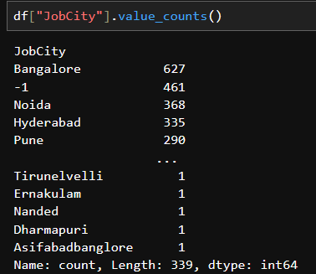
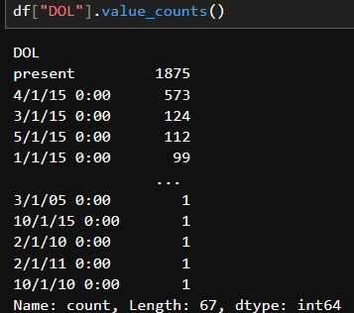
Data Cleaning and Data manipulation
In this DOL column unwanted names are present in this data.
We have the change present to max date
In this jobCity mismatch items occur,.
I change the value num to cat
Here I done the data cleaning

Slide 7
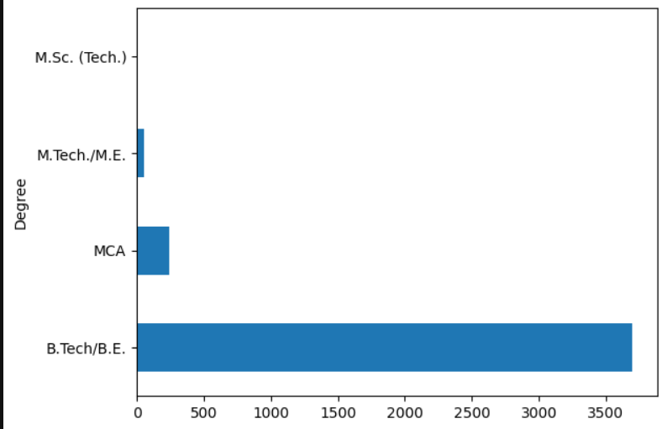
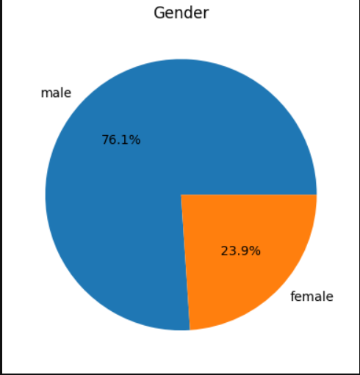
Univariate analysis categorical columns
This is the representation of gender percentages
We can see that the graph male percentage is more than 2 times of female
This is the representation of the degree column
In this graph, B-tech students are in the first
The second highest is MCA

Slide 8
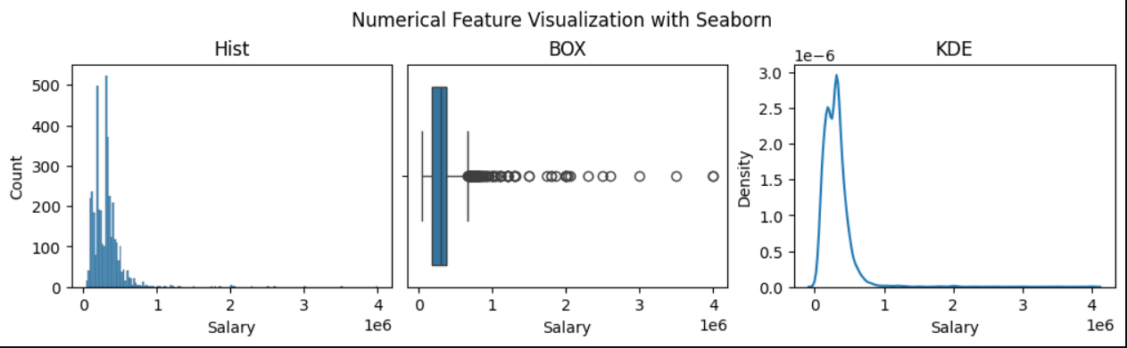
Univariate analysis of numerical columns
This represents the distribution Salary column.
Distribution for using Seaborn.
The box plot is used for outliers.
KDE plot distributes the numerical data, Salary column is right skew dist

Slide 9
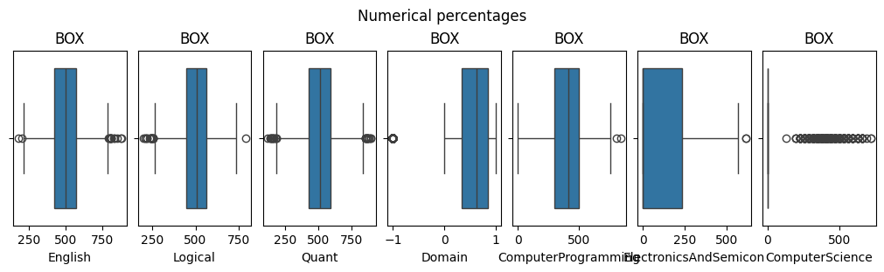
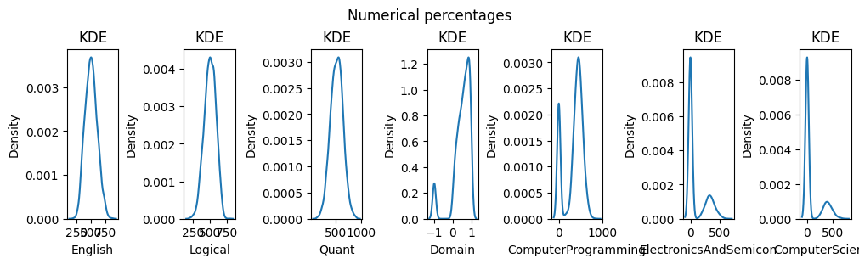

Slide 10
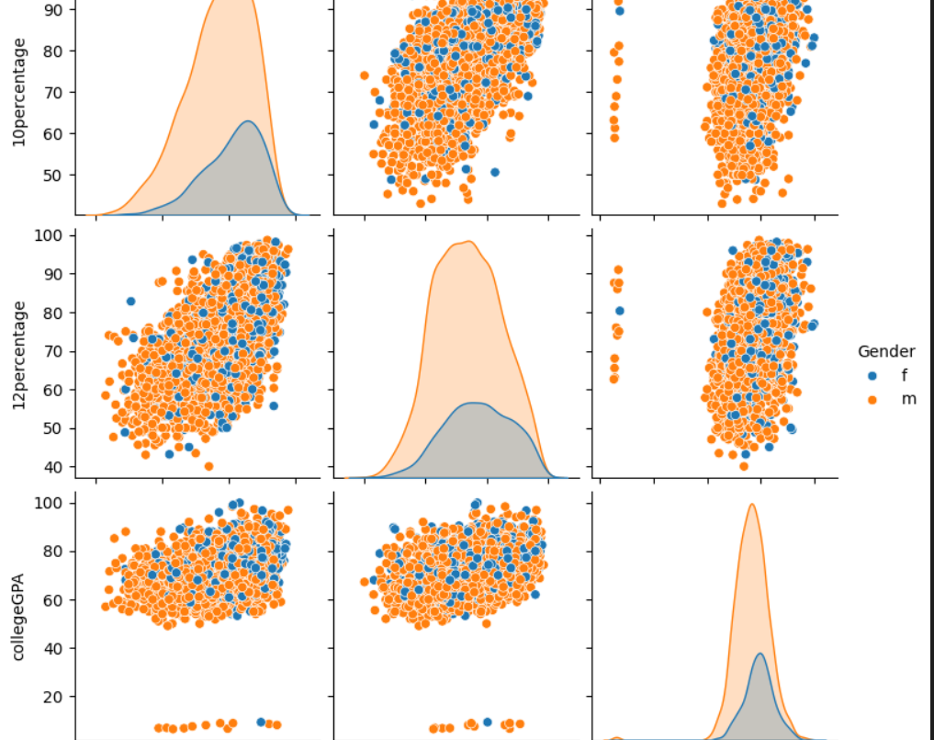
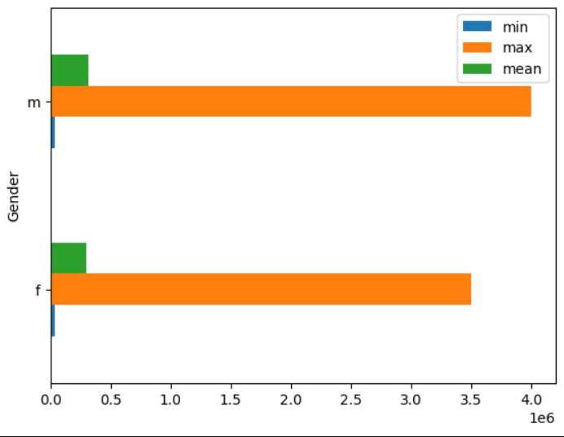
Bivariate Analysis Steps
Num vs Num
Num vs cat ( salary, Gender)
In Bivariate analysis taken this columns Salary, Gender.
Here using the plot of bar
In this plot male persons are got a salary of 3.9, min(0.25)
Female persons got the max salary of 3.5, min(0.25)
This is num vs num columns.
Here using the pair plot for these three columns based on the Gender column
Here blue is represents the female
Red is represent the male

Slide 11
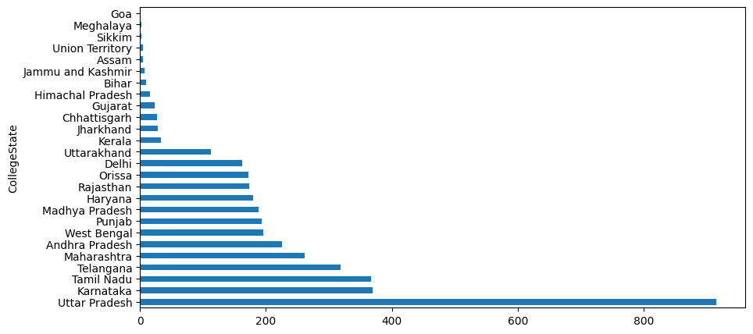
College States
Uttar Pradesh 915,
Karnataka 370,
Tamil Nadu 367 ,
Telangana 319,
Maharashtra 262.
Andhra Pradesh 225,
West Bengal 196,
Punjab 193,
Madhya Pradesh 189,
Haryana 180,
Rajasthan 174,
Orissa 172,
Delhi 162,
Uttarakhand 113,
Kerala 33,
Jharkhand 28,
Chhattisgarh 27,
Gujarat 24 ,
Himachal Pradesh 16,
Bihar 10,
Jammu and Kashmir 7,
Assam 5 ,
Union Territory 5 ,
Sikkim 3 ,
Meghalaya 2 ,
Goa 1

Slide 12
Conclusion :
From the analysis Done on Aspiring minds employees , the salaries of the employees is varying based on different features.
The salary of most of the employees is below 5 lakhs.
The minimum num fo employees are from B-tech/ B.E background
In the company , here is a domination of male count over female count.
The Salary of the employment is based on the specialization,Degree, Designstion, it is not depends on the 10th and 12th grades.
The employees with M-tech degree have a higher salary compare to other degrees.
All the make are having salary as compare to the female.

Slide 13

THANK YOU

